Slide 1
Mobile app security_
April 2025

Slide 2
First security steps_
Where to start
Storing sensitive data in Secure storage
ProGuard
SSL encryption
Universal/App links over custom uri link

Slide 3
Used tool_
Burp Suite
Software security application used for penetration testing
HTTP(s) websockets proxy and history

Slide 4
SSL Pinning_

Slide 5
SSL Pinning_
SSL pinning is a technique that helps to prevent MITM attacks.
SSL/TLS certificate’s public key is hardcoded inside the app or device.
The server’s SSL/TLS certificate’s public key is compared with the one that is hardcoded into the app or device.
What we are using
react-native-ssl-public-key-pinning
If they match, the connection is considered secure.

Slide 6
Used tool_
Frida
Code instrumentation toolkit
Allows to inject JS snippet into native apps
Objection
Runtime mobile exploration toolkit
Powered by Frida

Slide 7
Hook detection_

Slide 8
Hook detection_
Hooks are snippets of code that are used to intercept or modify the behavior of applications.
Check the environment where app is running
If hook detected prevent app to run
What we are using
freeRASP
eRASP

Slide 9
More to take care_

Slide 10
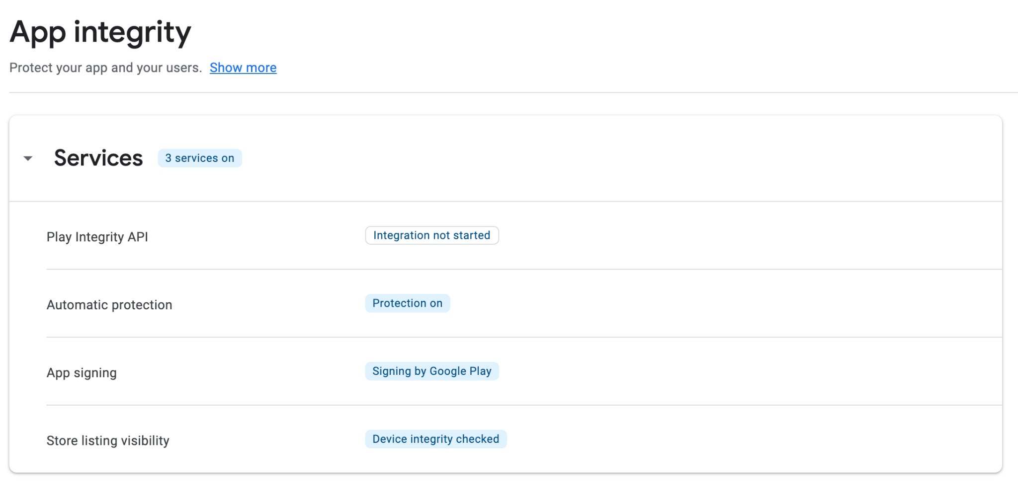
Enable App integrity_
Enabled the Google app store integrity protection to control under which circumstances app is running.
c

Slide 11
iOS Cache_
Sensitive data can easily leak from application caches.
Cache.db file is a DB file where all the requests made via NSURLRequest are cached.
Solution:
Disable explicitly cache for NSURLRequest
[NSURLCache setSharedURLCache: [[NSURLCache alloc] initWithMemoryCapacity:0 diskCapacity:0 diskPath:0]];
[[NSURLSessionConfiguration defaultSessionConfiguration] setURLCache: nil];

Slide 12
StrandHogg attack_
The StrandHogg attack / Task Affinity vulnerability was enabled / caused by a design bug in the way Android handled multiple tasks, specifically the feature called task reparenting. Application task reparenting is a feature that allows an application to move an activity from one task to another.
Solution:
Set min SDK version 30
Mitigation:
Set up
android:launchMode="singleTask" android:taskAffinity="”
In the manifest if it is not possible to set min SDK to 30
More information
StrandHogg
eRASP

Slide 13
Questions?

